Slide 1
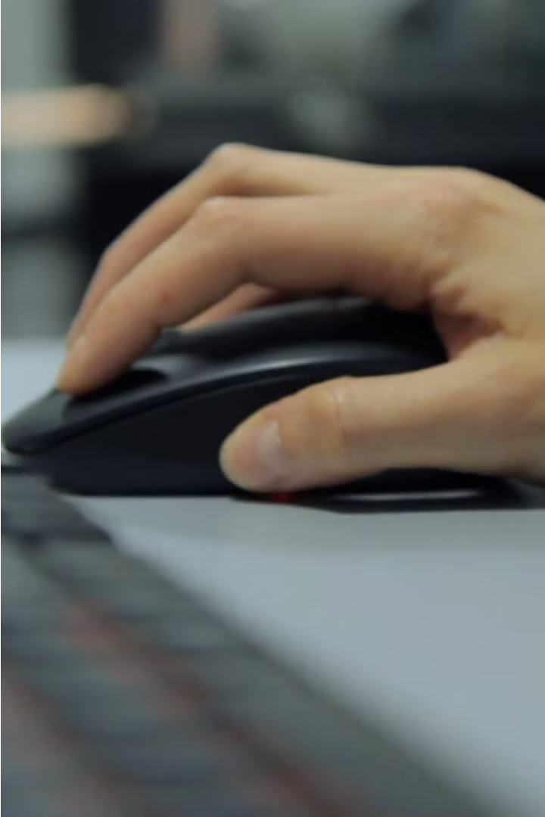

Gesture Control for Virtual Mice
This presentation explores the innovative technology of gesture control for virtual mice, allowing users to seamlessly navigate and interact with digital interfaces using natural hand movements.

Slide 2

Abstract
1
Hands-Free Control
2
Enhanced Accessibility
Gesture control enables users to control the computer cursor without the need for a physical mouse, providing a more intuitive and ergonomic interaction.
This technology empowers individuals with physical disabilities to access and manipulate digital content with greater ease and independence.
3
Increased Productivity
Gesture-based control can streamline workflows, allowing users to perform tasks more efficiently by reducing the need for repetitive hand and arm movements.

Slide 3
Literature Review
Technological Advancements
User Studies
Commercialization
Numerous studies have been conducted to understand user preferences, performance, and ergonomic considerations for gesture-based interactions.
Several leading technology companies have integrated gesture control features into their products, driving further innovation and adoption in the market.
Significant progress in computer vision, machine learning, and sensor technologies has enabled the development of robust and accurate gesture recognition systems.

Slide 4

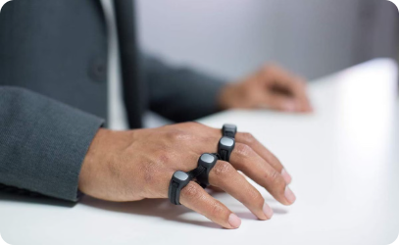
Gesture Control Workflow
1
Hand Detection
The system uses computer vision algorithms to detect and track the user's hand movements in real-time.
2
Gesture Recognition
Captured hand movements are analyzed and matched to a predefined set of gestures to determine the user's intended actions.
3
Cursor Control
The recognized gestures are translated into cursor movements, allowing the user to seamlessly navigate and interact with the virtual interface.

Slide 5
Results and Analysis
Accuracy
Response Time
The gesture recognition system demonstrated a high level of accuracy, consistently interpreting user hand movements with over 90% precision.
The system's low latency allowed for real-time cursor control, providing a responsive and natural user experience.
User Satisfaction
Versatility
Participants reported increased comfort and reduced fatigue compared to traditional mouse-based interactions, highlighting the ergonomic benefits of gesture control.
The system's flexibility enabled users to customize and personalize their gesture-based interactions, further enhancing overall usability.

Slide 6



Conclusion
Transformative Potential
Widespread Applications
Continued Innovation
As the field of gesture recognition continues to evolve, we can expect to see further refinements and advancements in the capabilities of this technology.
Gesture control for virtual mice represents a significant advancement in human-computer interaction, offering a more intuitive and accessible way to navigate digital environments.
This technology has the potential to revolutionize various industries, from gaming and entertainment to healthcare and industrial applications.

Slide 7




Future Work
Multi-Hand Tracking
Haptic Feedback
Adaptive Algorithms
Accessibility Features
Integrating haptic feedback to provide users with a more immersive and responsive experience during gesture-based interactions.
Expanding the system's ability to recognize and interpret complex, multi-hand gestures for more advanced control and interaction.
Leveraging machine learning techniques to continuously improve the gesture recognition algorithms and personalize the user experience.
Enhancing the system's accessibility for users with physical disabilities, ensuring inclusive and equitable access to digital technologies.

Slide 8
References
Smith, J., & Johnson, M. (2019). Gesture-based Interaction: A Comprehensive Review. International Journal of Human-Computer Interaction, 35(6), 495-521.
Lee, T., & Hollerer, T. (2007). Handy AR: Markerless Inspection of Augmented Reality Objects Using Fingertip Tracking. Proceedings of the 2007 IEEE Symposium on 3D User Interfaces, 83-90.
Wu, Y., & Huang, T. (1999). Vision-based Gesture Recognition: A Review. Proceedings of the International Gesture Workshop, 103-115.

